Slide 1

OT LABORATEGI BIRTUALAK
3.-PLC Siemens Birtuala (Tia Portal+PLCSIM+Nettoplcsim > Factory)
Notes:
n

Slide 2
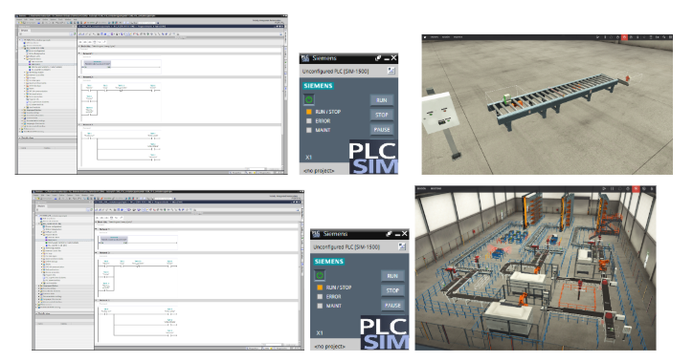
3.-PLC Siemens Birtuala (Tia Portal+PLCSIM > Factory)
3.1 PLC Siemens Birtuala (Tia Portal+PLCSIM > Factory)

Slide 3
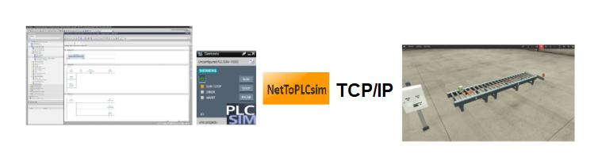
3.-PLC Siemens Birtuala (Tia Portal+PLCSIM > Factory)
3.2 PLC Siemens Birtuala (Tia Portal+PLCSIM > TCP/IP > Factory)
S7 1200 No Function block
IP PLC IP PLC IP ETH0 IP ETH0

Slide 4
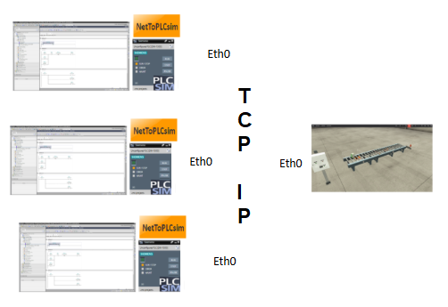
3.-PLC Siemens Birtuala (Tia Portal+PLCSIM > Factory)
3.3 PLC Siemens sare Birtuala (3 Tia Portal+PLCSIM+NetTOPLC > Factory)

Slide 5
3.-PLC Siemens Birtuala (Tia Portal+PLCSIM > Factory)
Konpartitutako fitxategiak:
Tia Portal proiektua V18. Factory IO eszenatoki sinplea.
Tia Portal proiektua V15 , V18. Factory IO eszenatoki konplexua.

Slide 6
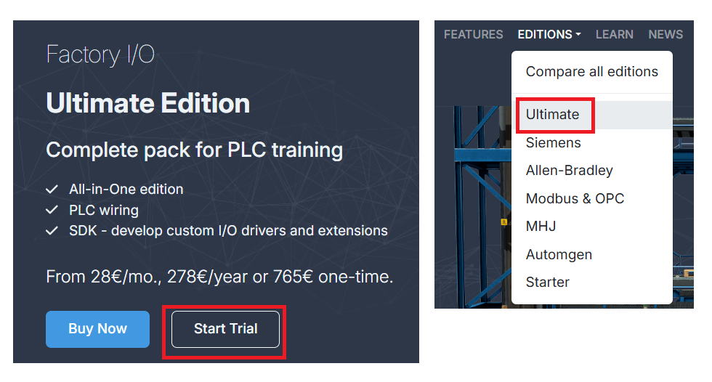

3.-PLC Siemens Birtuala (Tia Portal+PLCSIM > Factory)
Factory IO : Aplikazioa, Gida, Templates , Proiektua

Slide 7
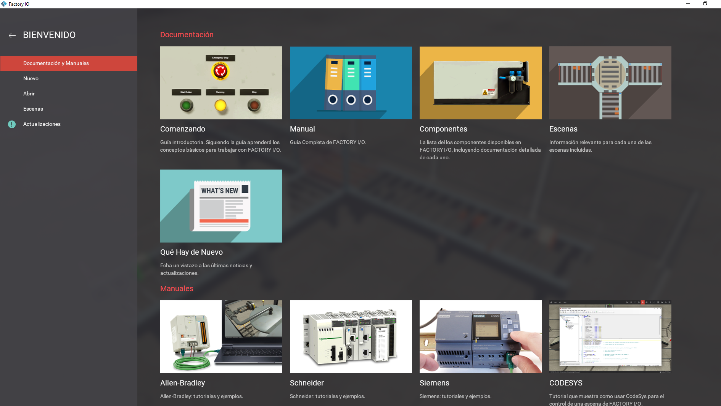
3.-PLC Siemens Birtuala (Tia Portal+PLCSIM > Factory)

Slide 8
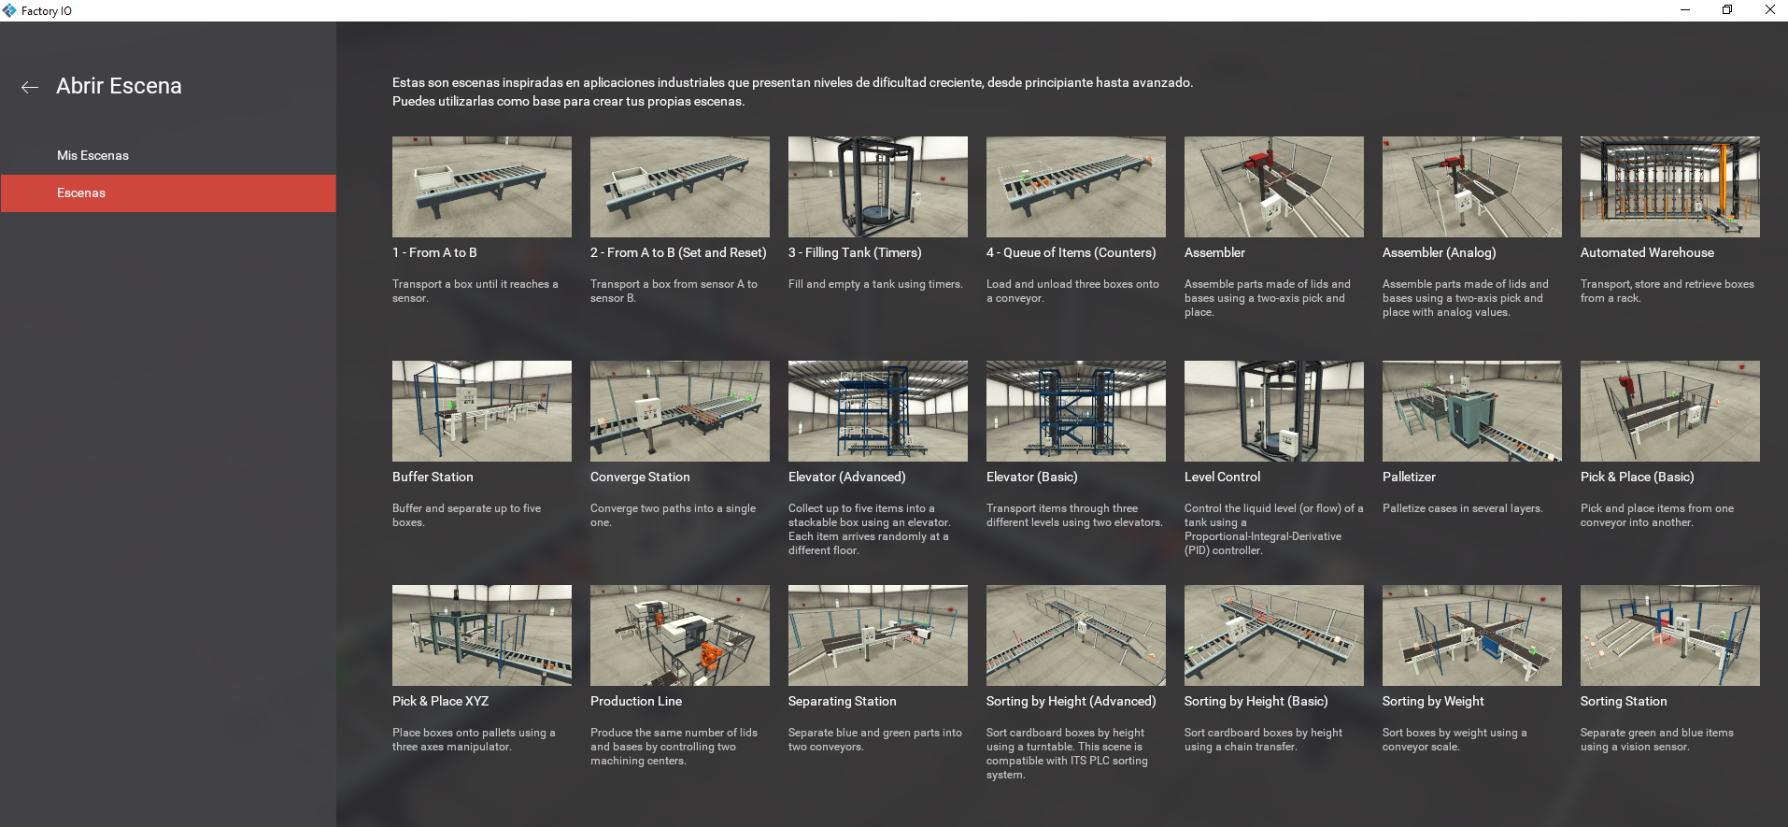
3.-PLC Siemens Birtuala (Tia Portal+PLCSIM > Factory)

Slide 9
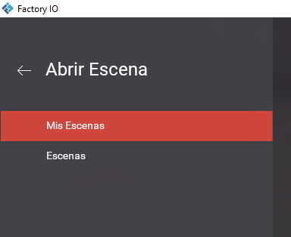
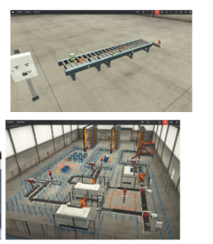
3.-PLC Siemens Birtuala (Tia Portal+PLCSIM > Factory)

Slide 10
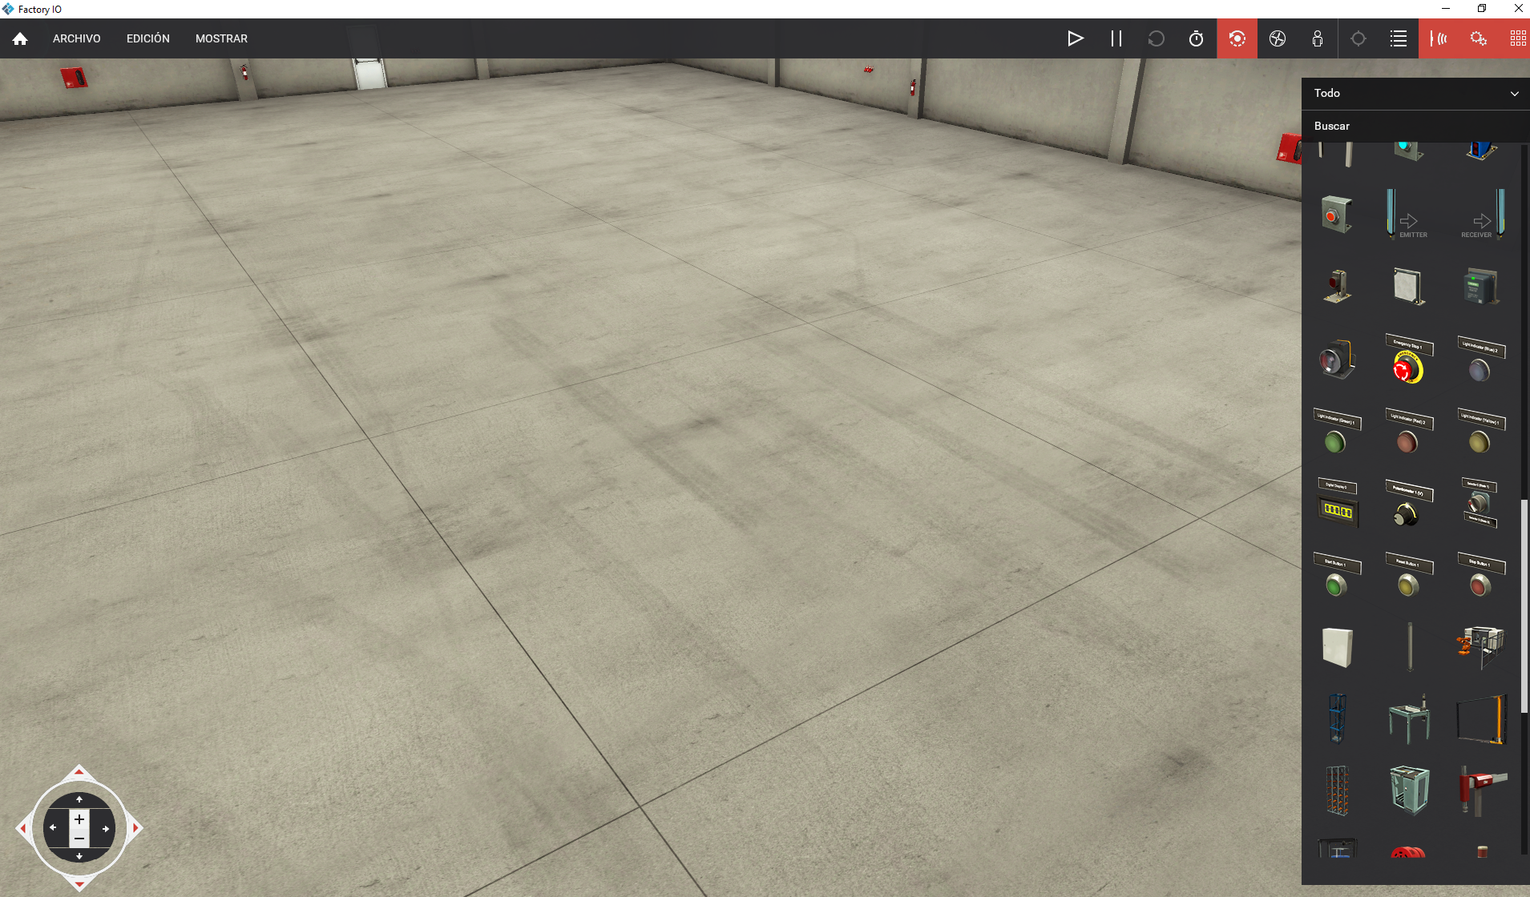
3.-PLC Siemens Birtuala (Tia Portal+PLCSIM > Factory)

Slide 11
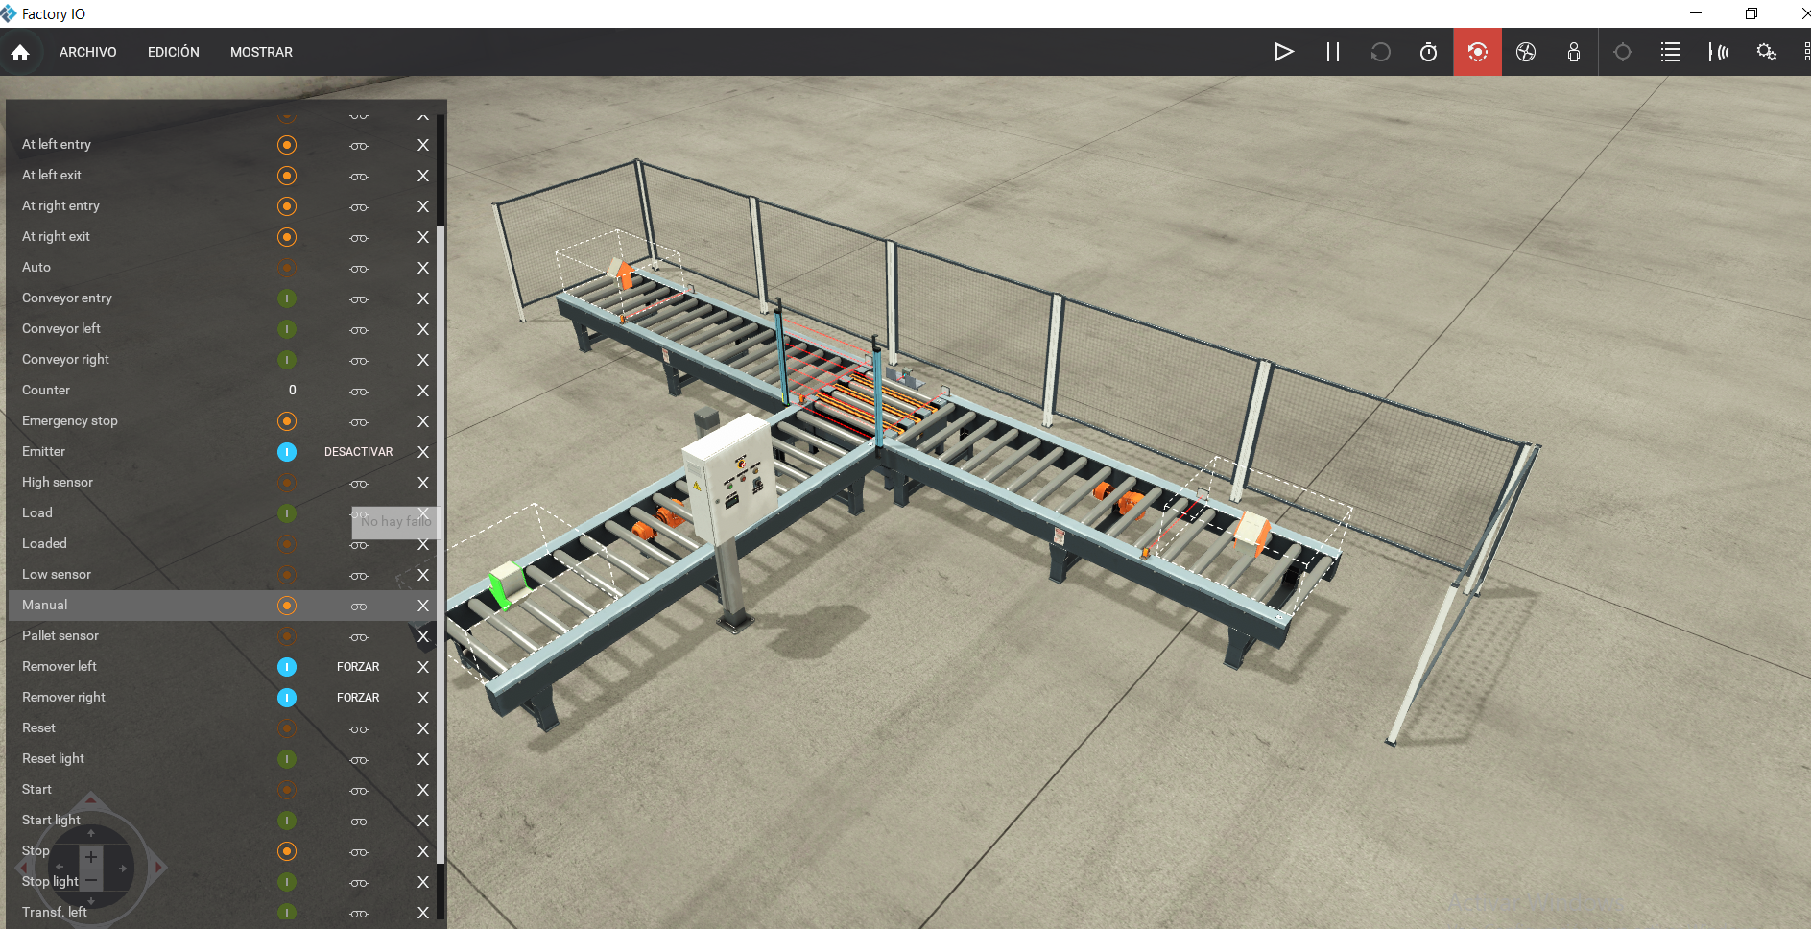
3.-PLC Siemens Birtuala (Tia Portal+PLCSIM > Factory)

Slide 12
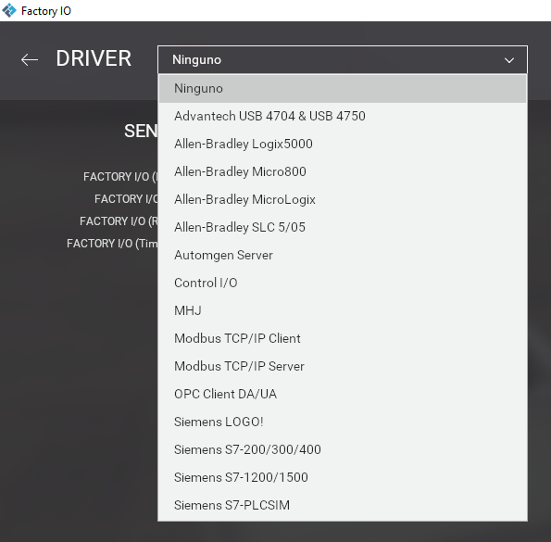
3.-PLC Siemens Birtuala (Tia Portal+PLCSIM > Factory)

Slide 13
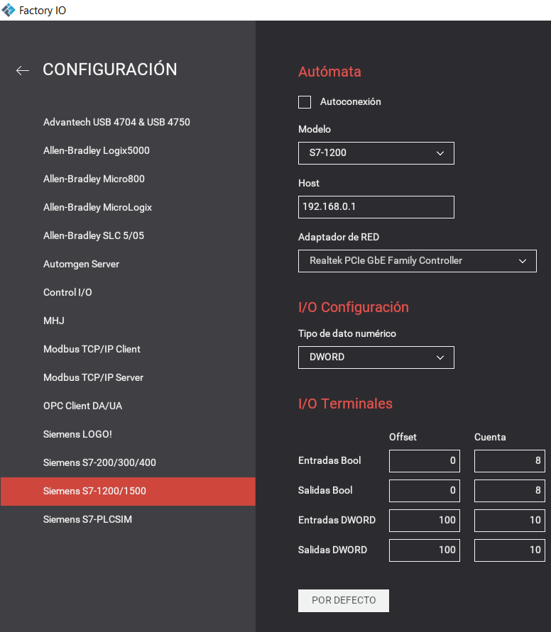
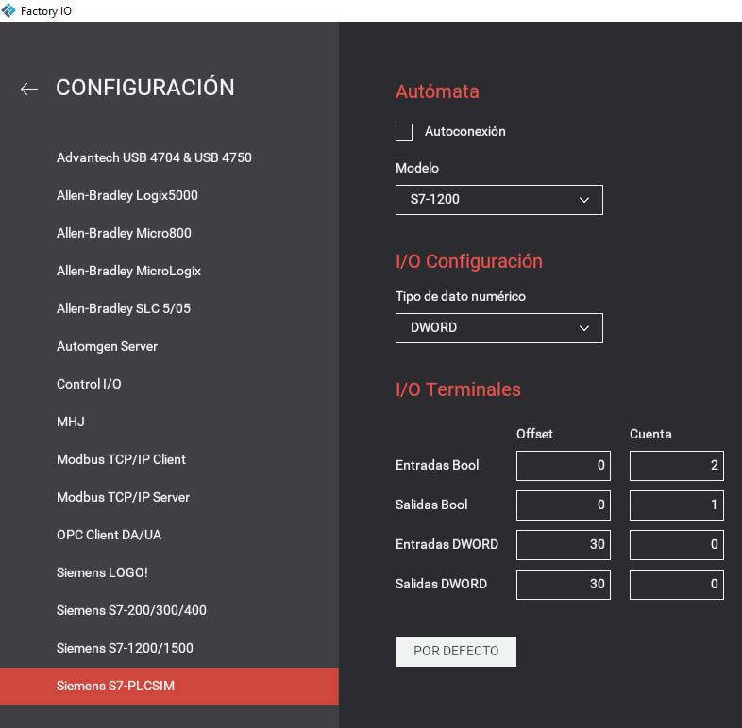
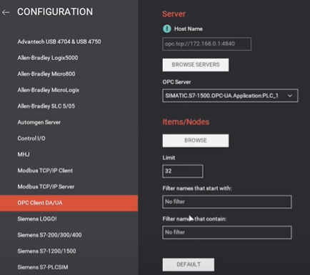
3.-PLC Siemens Birtuala (Tia Portal+PLCSIM > Factory)
PLC fisikoa, nettoplcsim
PLCSIM
PLCServer, Kepserve

Slide 14
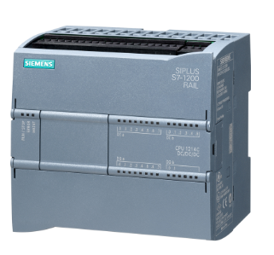
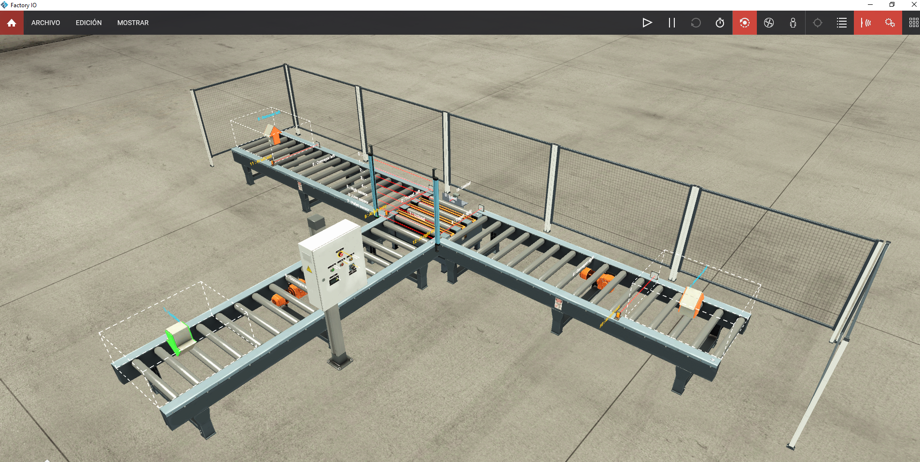
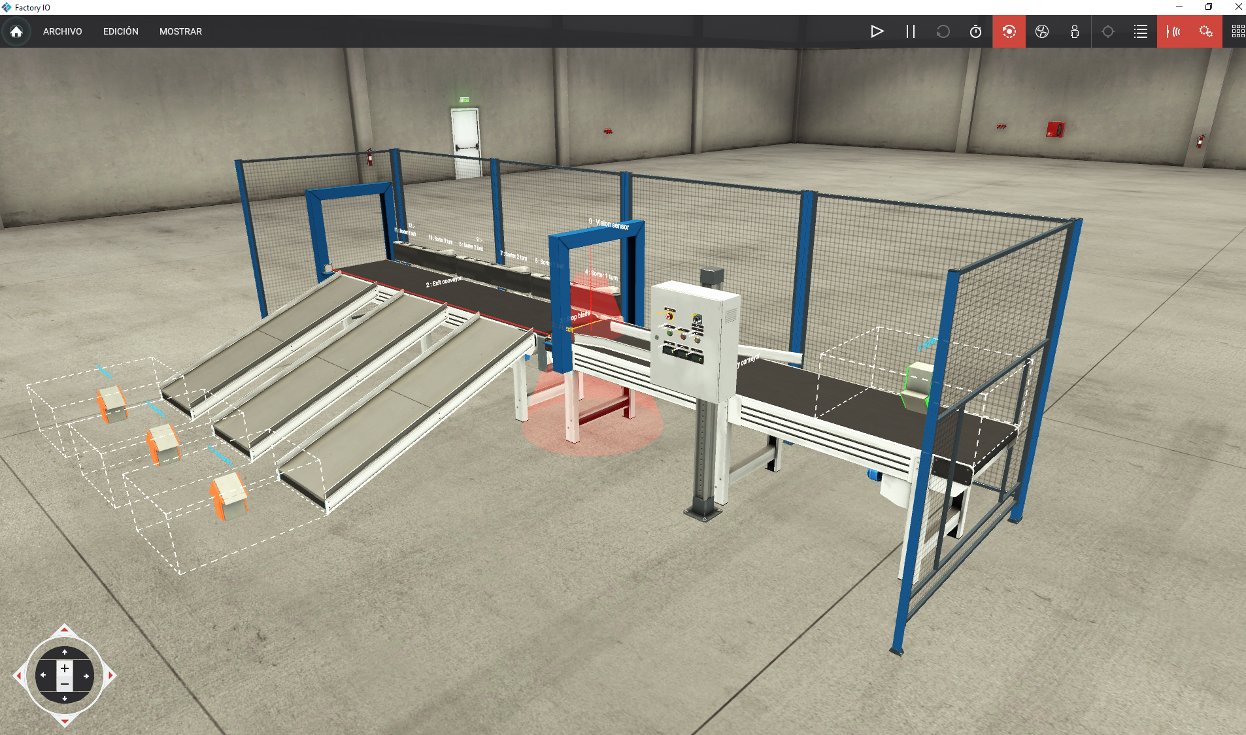
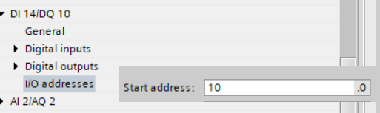
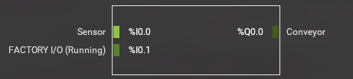
3.-PLC Siemens Birtuala (Tia Portal+PLCSIM > Factory)
192.168.0.1
KONTUZ

Slide 15
3.1 -PLC Siemens Birtuala (Tia Portal+PLCSIM > Factory)

Slide 16
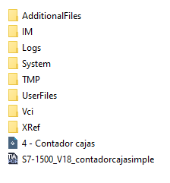
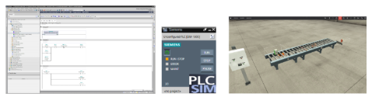

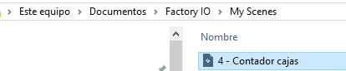
3.1 -PLC Siemens Birtuala (Tia Portal+PLCSIM > Factory)
Konpartitutako fitxategiak:
Tia Portal proiektua V18. Factory IO .Eszenatoki sinplea.

Slide 17
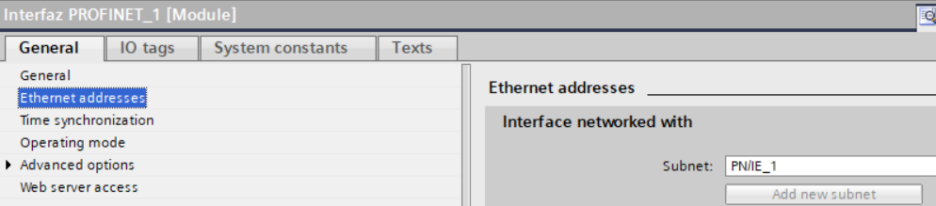
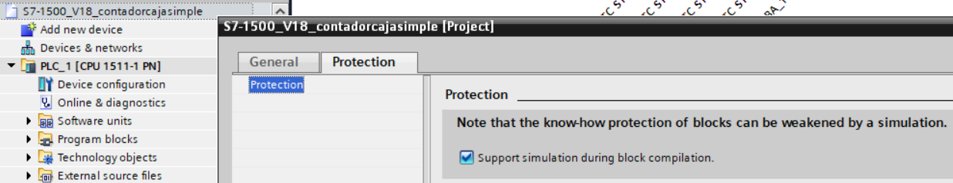
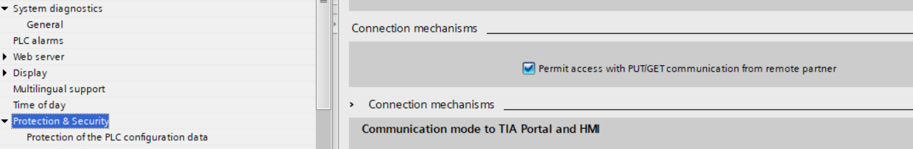
3.1 -PLC Siemens Birtuala (Tia Portal+PLCSIM > Factory)
TIA PORTAL (PLCSIM)
Kontutan izatekoak!!

Slide 18
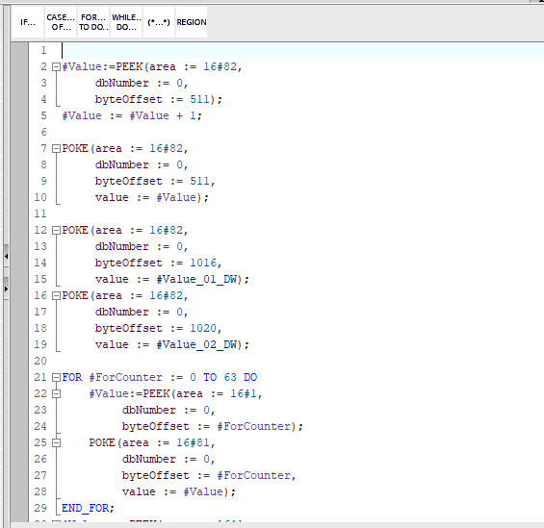
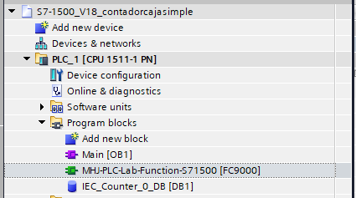
3.1 -PLC Siemens Birtuala (Tia Portal+PLCSIM > Factory)
TIA PORTAL (PLCSIM)

Slide 19
3.1-PLC Siemens Birtuala (Tia Portal+PLCSIM > Factory)
El módulo MHJ PLC-Lab Function en TIA Portal se utiliza como un puente de comunicación entre un PLC virtual programado en TIA Portal (generalmente usando PLCSIM o PLCSIM Advanced) y aplicaciones de simulación externas como Factory I/O.
Proporciona bloques de funciones (FBs) que gestionan el intercambio de datos.
Facilita el mapeo de entradas/salidas físicas simuladas de Factory I/O con las variables internas del PLC

Slide 20
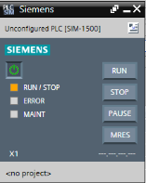
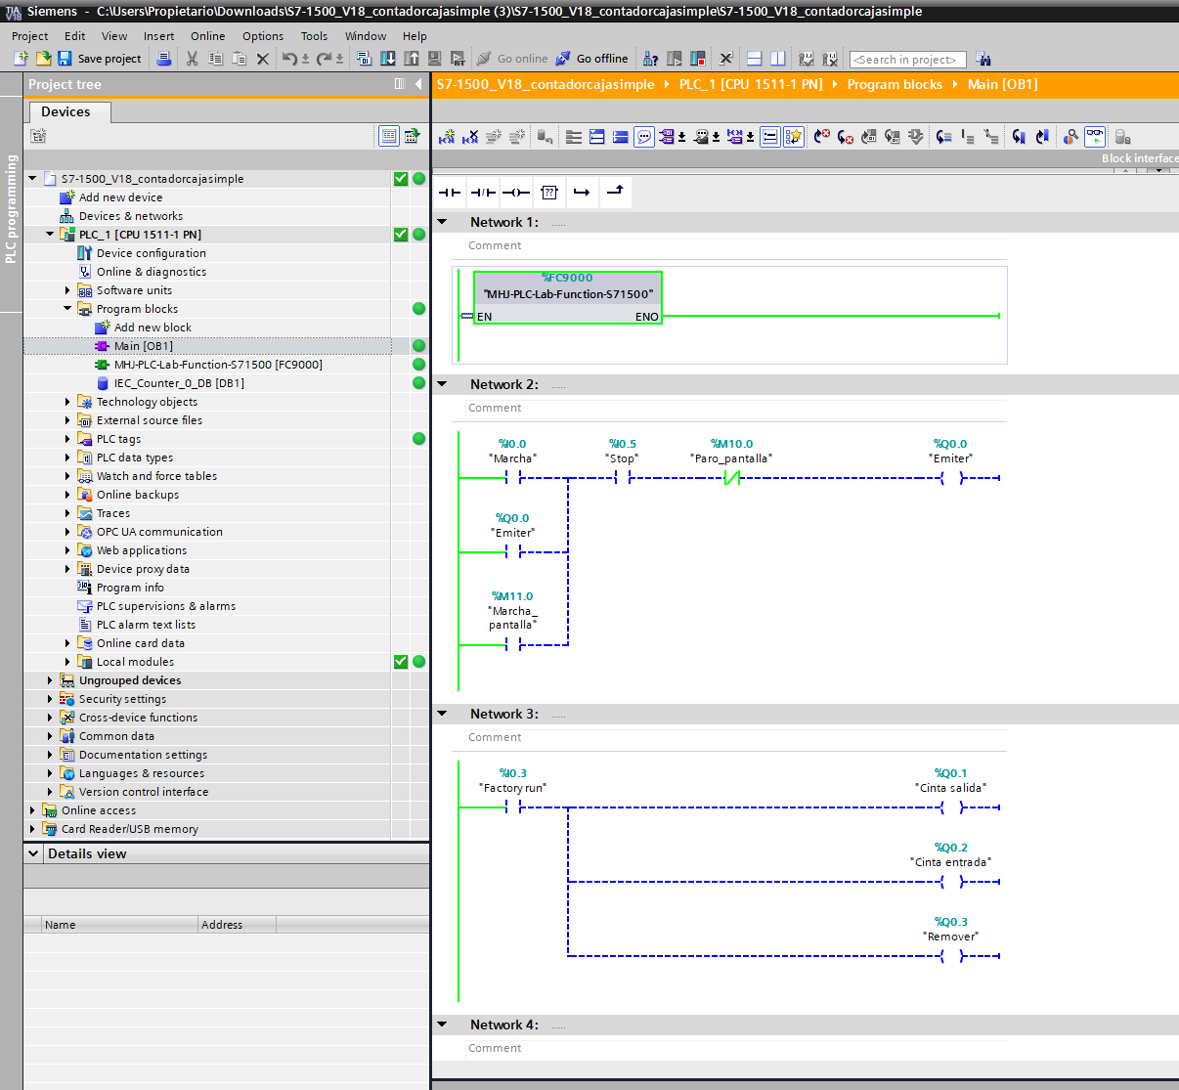
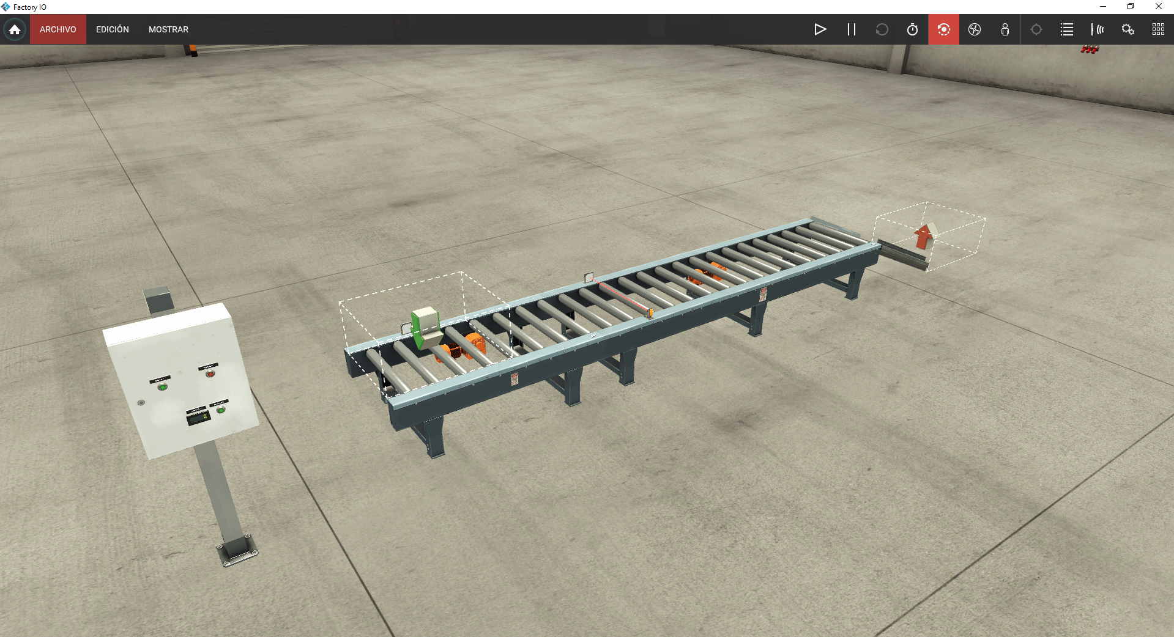
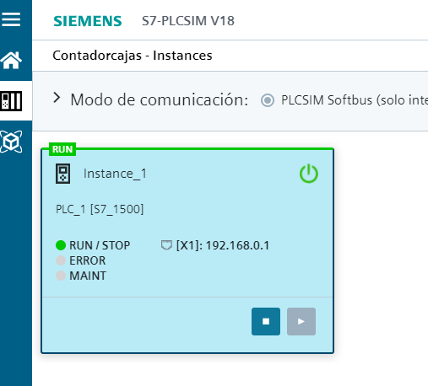
3.1-PLC Siemens Birtuala (Tia Portal+PLCSIM > Factory)

Slide 21
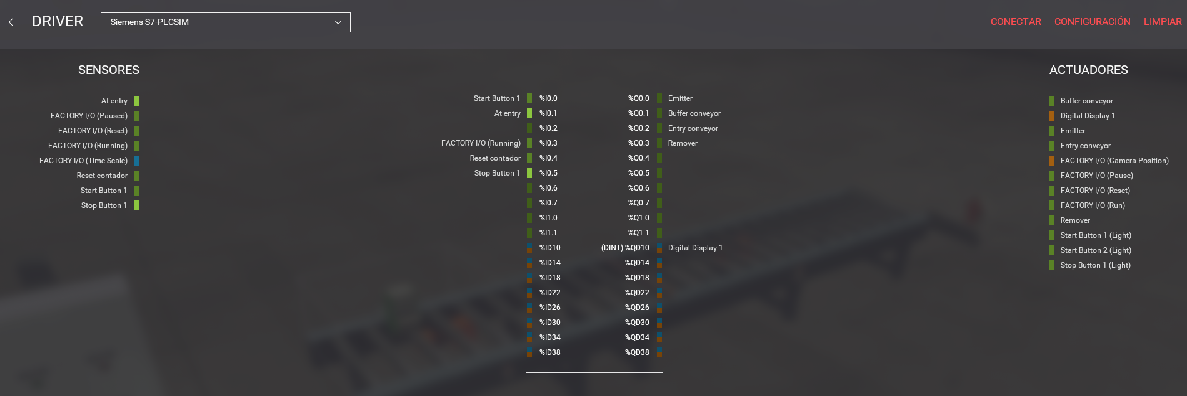
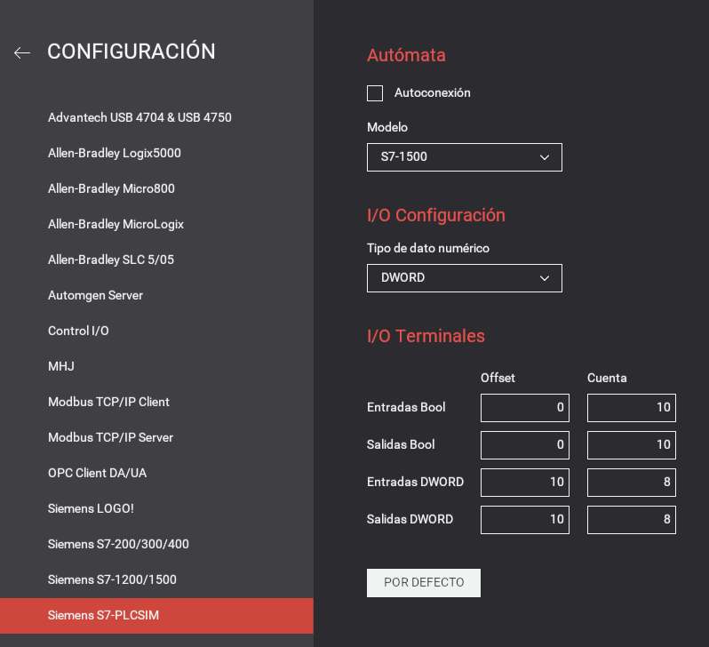
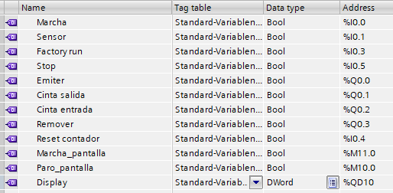
3.-PLC Siemens Birtuala (Tia Portal+PLCSIM > Factory)

Slide 22
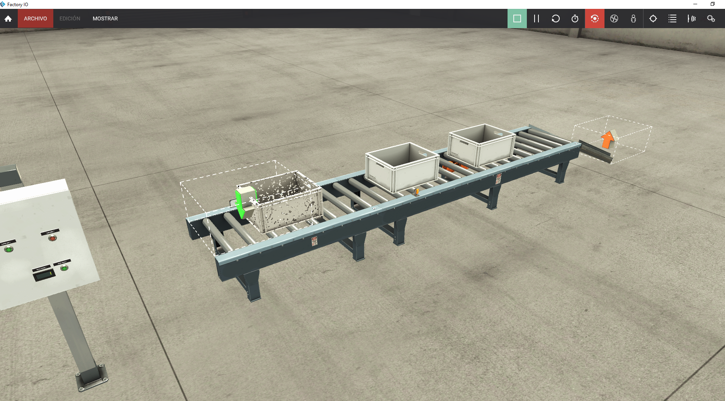

3.1-PLC Siemens Birtuala (Tia Portal+PLCSIM > Factory)

Slide 23


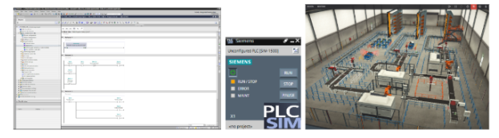
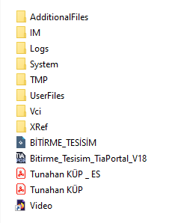
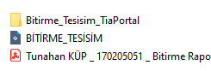
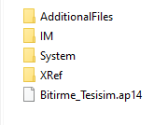
3.1 -PLC Siemens Birtuala (Tia Portal+PLCSIM > Factory)
Konpartitutako fitxategiak:
Tia Portal proiektua V15 V18. Factory IO eszenatoki konplexua.
Eszenatoki konplexuaren dokumentazioa eta proiektua .
https://www.youtube.com/watch?v=AVNz5rwUxV8
https://drive.google.com/drive/folders/13NG9Vxsngg1p4F7U_yWuzFLnoSTmoXrU

Slide 24
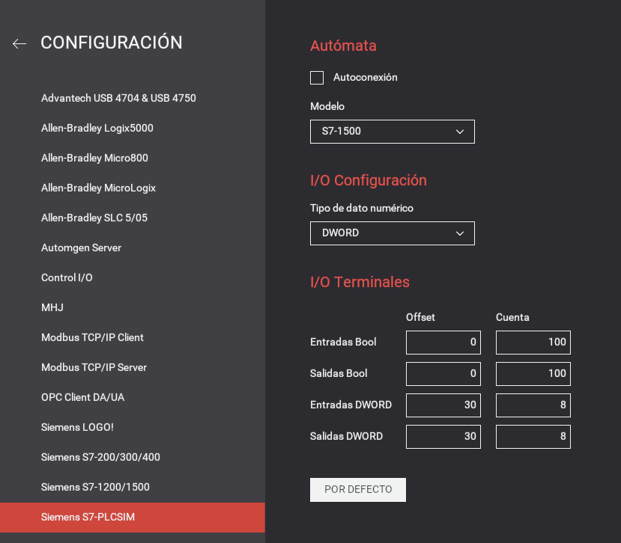
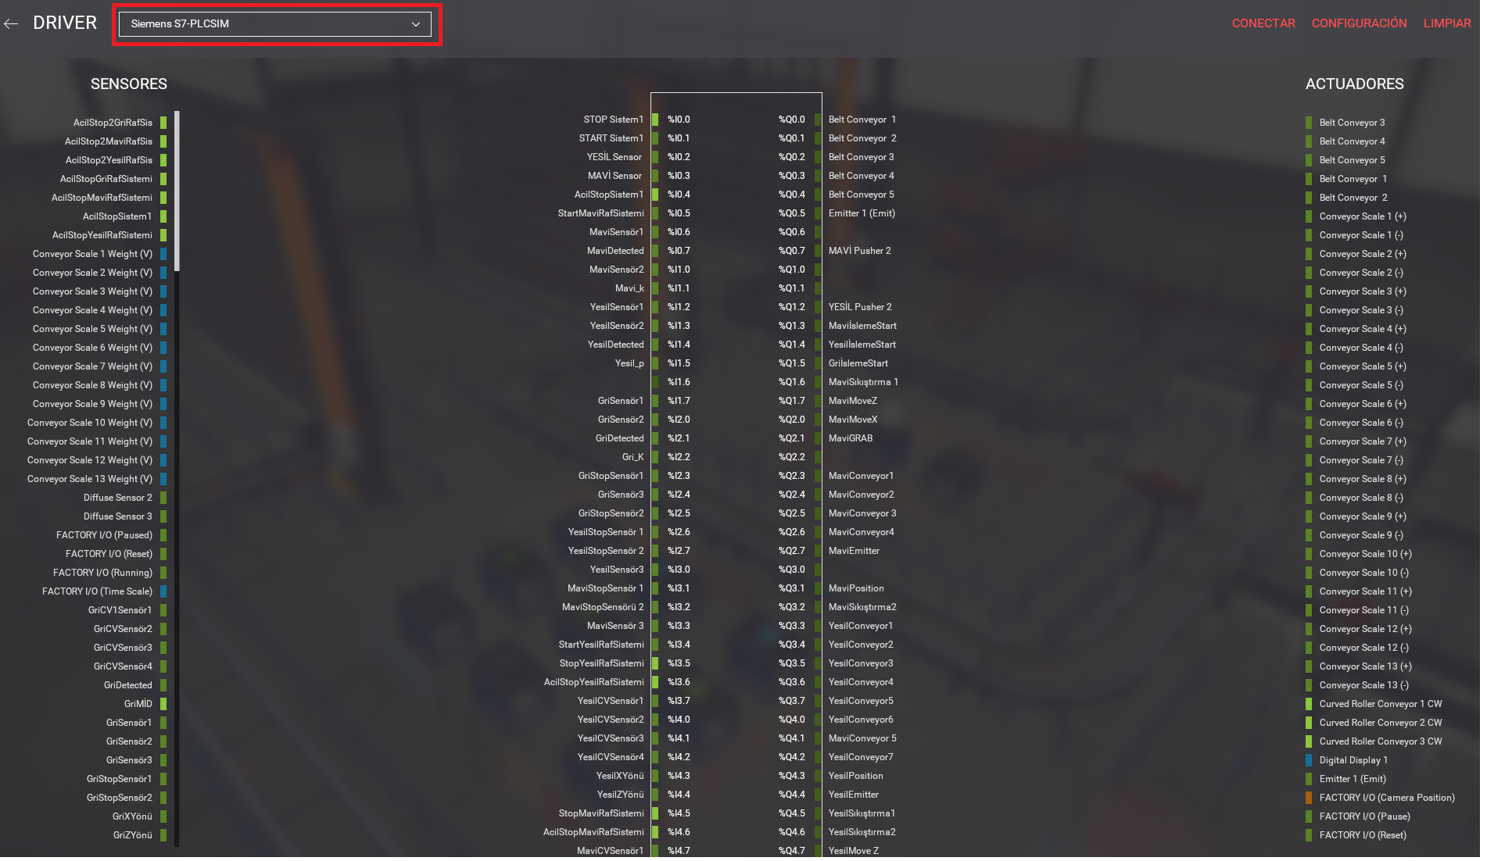
3.1 -PLC Siemens Birtuala (Tia Portal+PLCSIM > Factory)

Slide 25
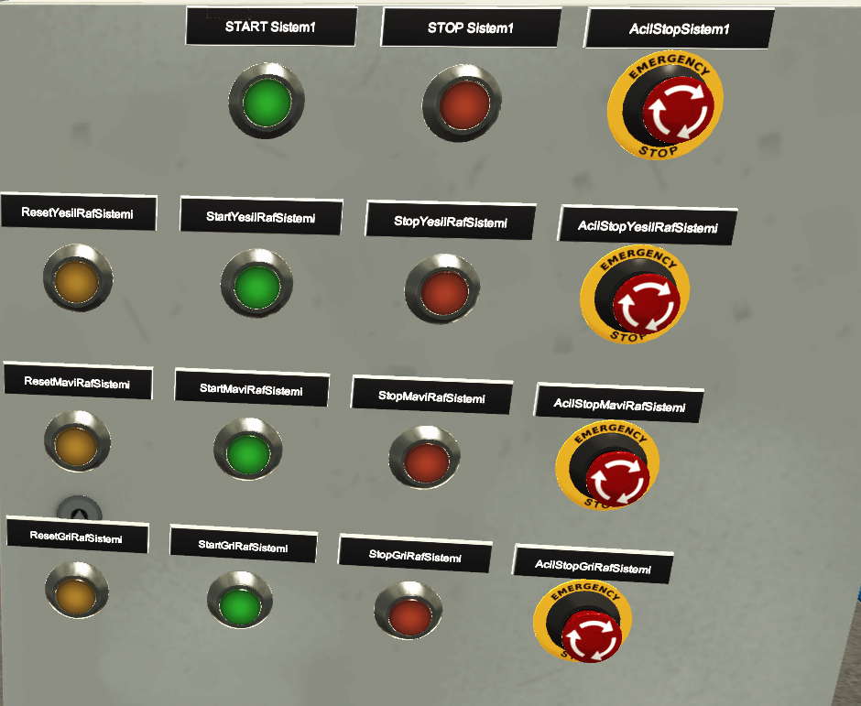
3.1 -PLC Siemens Birtuala (Tia Portal+PLCSIM > Factory)
Reset biltegiak 1,2,3
Martxa biltegiak 1,2,3
Martxa START Sistem
Kamera posizioak aldatu
Abiadura handitu?

Slide 26
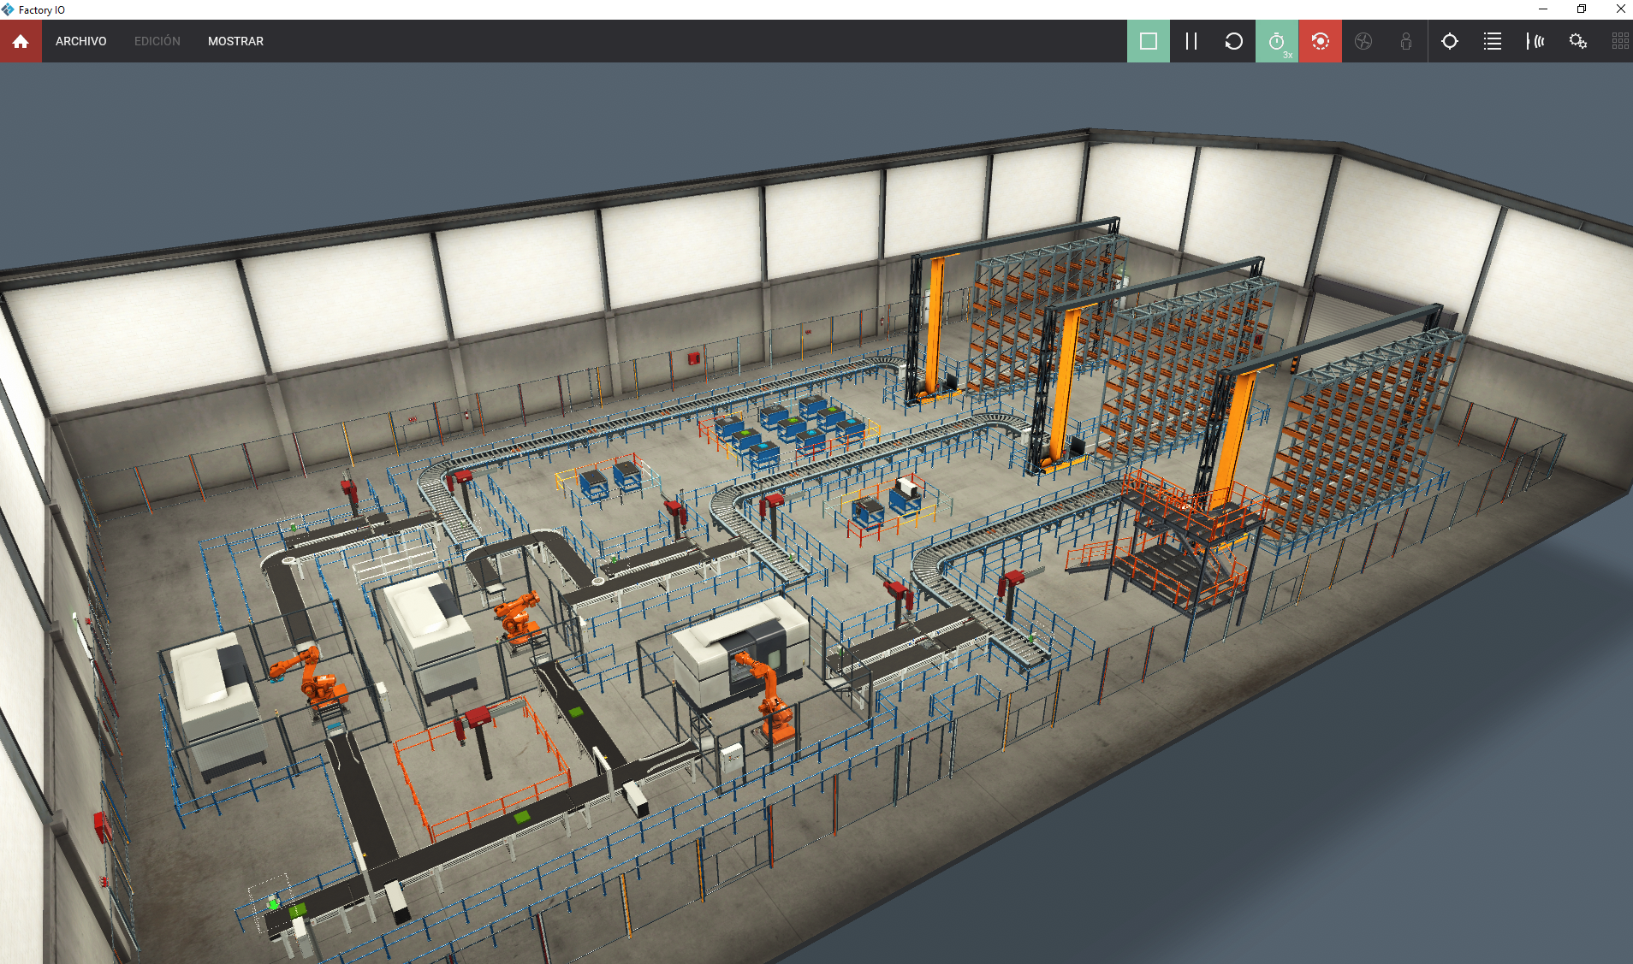
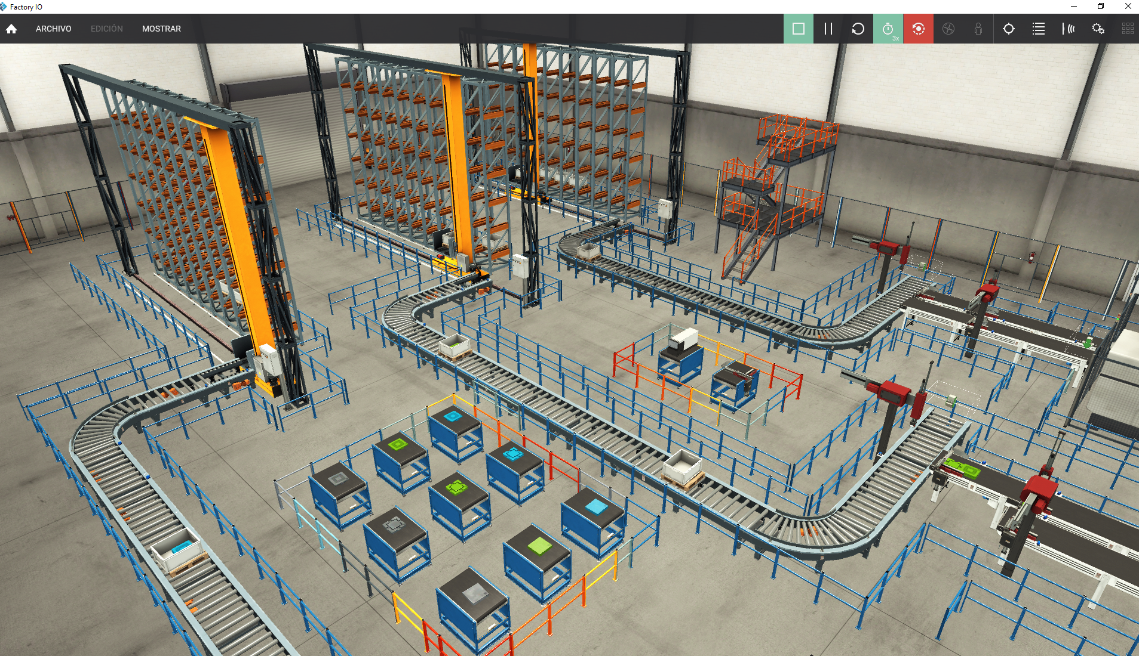
3.1 -PLC Siemens Birtuala (Tia Portal+PLCSIM > Factory)

Slide 27
3.2-PLC Siemens Birtuala
(Tia Portal + PLCSIM + NetToplcsim > Factory)

Slide 28
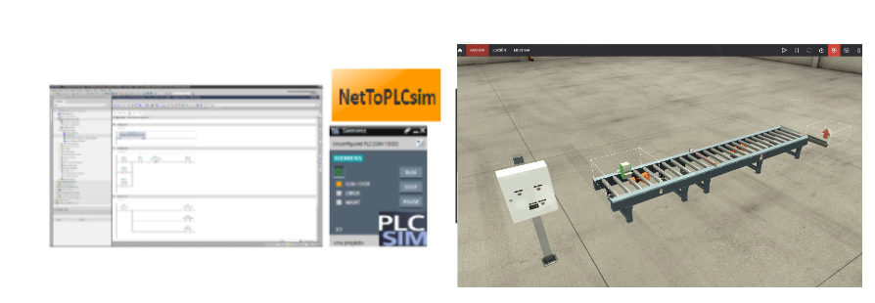
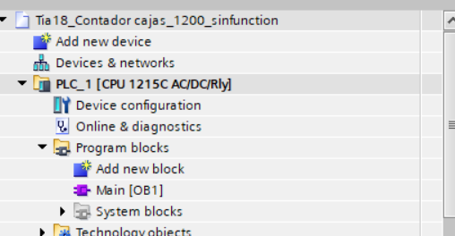

3.2-PLC Siemens Birtuala (Tia Portal + PLCSIM + Nettoplcsim > Factory)
S7 1200
No Function block

Slide 29
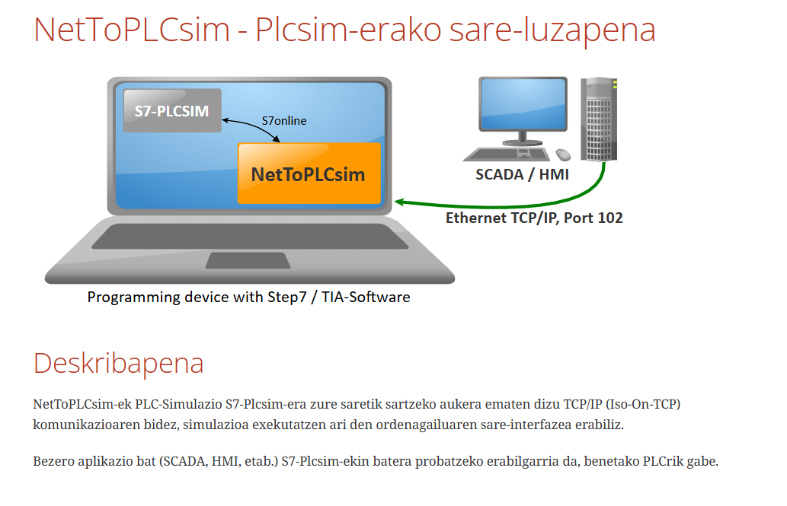
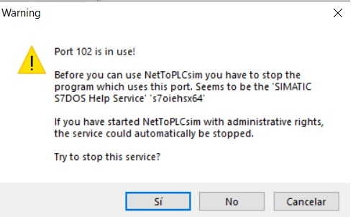
3.-PLC Siemens Birtuala (Tia Portal+PLCSIM+Nettoplcsim > Factory)
NetToPLCSim permite conectar Factory I/O con PLCSIM aunque PLCSIM por defecto no acepta conexiones externas por red. Aquí es donde entra NetToPLCSim, actuando como un puente que permite esa comunicación.
Descarga

Slide 30

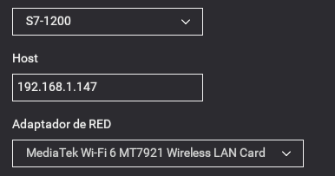
3.-PLC Siemens Birtuala (Tia Portal+PLCSIM > Factory)
3.2 PLC Siemens sare Birtuala (3 Tia Portal+PLCSIM+NetTOPLC > Factory)
S7 1200 No Function block
PLC:192.168.4.152 PLCSIM:192.168.4.152
IP WIFI:192.168.1.147 Configuracion IP ETH0 IP

Slide 31
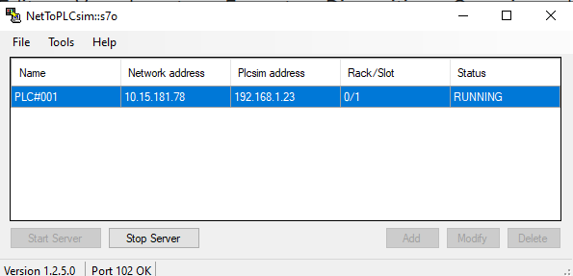


3.-PLC Siemens Birtuala (Tia Portal+PLCSIM > Factory)
1- Tia Portal ireki
2- NetToPLCsim ireki, ez konfiguratu
3- PLCSIM exekutatu Tia Portal bidez
4- NetToPLCsim konfiguratu , abiatu
5- Factory erabili

Slide 32

3.-PLC Siemens Birtuala (Tia Portal+PLCSIM > Factory)

Slide 33
3.-PLC Siemens Birtuala (Tia Portal+PLCSIM > Factory)

Slide 34


3.-PLC Siemens Birtuala (Tia Portal+PLCSIM > Factory)

Slide 35


3.-PLC Siemens Birtuala (Tia Portal+PLCSIM > Factory)

Slide 36

3.-PLC Siemens Birtuala (Tia Portal+PLCSIM > Factory)
Sensorea manipulatu

Slide 37

3.-PLC Siemens Birtuala (Tia Portal+PLCSIM > Factory)
Reseta manipulatu

Slide 38


3.-PLC Siemens Birtuala (Tia Portal+PLCSIM > Factory)
3.3 PLC Siemens sare Birtuala (3 Tia Portal+PLCSIM+NetTOPLC > Factory)
DB kontagailua manipulatu

Slide 39

3.-PLC Siemens Birtuala (Tia Portal+PLCSIM > Factory)
3.3 PLC Siemens sare Birtuala (3 Tia Portal+PLCSIM+NetTOPLC > Factory)
DB kontagailua manipulatu

Slide 40

3.-PLC Siemens Birtuala (Tia Portal+PLCSIM > Factory)

Slide 41

3.-PLC Siemens Birtuala (Tia Portal+PLCSIM > Factory)
3.3 PLC Siemens sare Birtuala (3 Tia Portal+PLCSIM+NetTOPLC > Factory)
Script bidez manipulatu

Slide 42
3.3-PLC Siemens Sare Birtuala
(Tia Portal + PLCSIM + NetToplcsim > Factory)

Slide 43
3.-PLC Siemens Birtuala (Tia Portal+PLCSIM > Factory)
3.3 PLC Siemens sare Birtuala (3 Tia Portal+PLCSIM+NetTOPLC > Factory)
IP1
IP2
IP3
Ez aldi berean
Simuladore bakarra

Slide 44

3.-PLC Siemens Birtuala (Tia Portal+PLCSIM > Factory)
3.2 PLC Siemens sare Birtuala (3 Tia Portal+PLCSIM+NetTOPLC > Factory)
S7 1200 No Function block
PLC:192.168.4.152 PLCSIM:192.168.4.152
IP WIFI:192.168.1.147 Configuracion IP ETH0 IP

Slide 45



3.-PLC Siemens Birtuala (Tia Portal+PLCSIM > Factory)
3.4 PLC Siemens sare Birtuala ( Tia Portal OPC server+PLCSIM Advance > Factory client)
*Ez da frogatu
Video
PLCSIM ADVANCE

Slide 46
3.-PLC Siemens Birtuala (Tia Portal+PLCSIM > Factory)
SORTING BY HEIGHT PROIEKTUA

Slide 47


3.-PLC Siemens Birtuala (Tia Portal+PLCSIM > Factory)
Proiektua eta templatea

Slide 48

3.-PLC Siemens Birtuala (Tia Portal+PLCSIM > Factory)
S7-1200 Function EZ
S7-1200 Nettoplcsim

